Slide 1

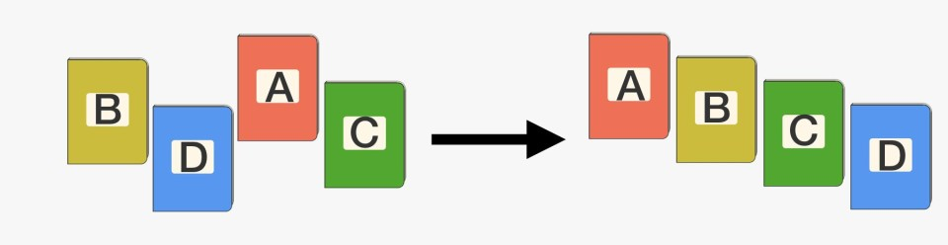
Chapter 6: Non-comparison Sorting
DESIGN & ANALYSIS OF ALGORITHM (BCSC0012)

Slide 2
How Fast Can We Sort?
 | Best | Average | Worst
Selection Sort | Ω(n^2) | θ(n^2) | O(n^2)
Bubble Sort | Ω(n) | θ(n^2) | O(n^2)
Insertion Sort | Ω(n) | θ(n^2) | O(n^2)
Merge Sort | Ω(n log(n)) | θ(n log(n)) | O(n log(n))
Quick Sort | Ω(n log(n)) | θ(n log(n)) | O(n^2)
Heap Sort | Ω(n log(n)) | θ(n log(n)) | O(n log(n))
What is common to all these algorithms?
Make comparisons between input elements
a_{i} < a_{j}, a_{i} ≤ a_{j}, a_{i} = a_{j}, a_{i} ≥ a_{j}, or a_{i} > a_{j}
To sort n elements, comparison sorts must make Ω(nlgn) comparisons in the worst case.

Slide 3
Can we do better?
Linear sorting algorithms
Counting Sort
Radix Sort
Bucket sort
Make certain assumptions about the data
Linear sorts are NOT “comparison sorts”

Slide 4


Slide 5
Counting Sort
for i ← 1 to k
do C[i] ← 0;
for j ← 1 to length[ A]
do C[ A[ j]] ← C[ A[ j]] + 1; for i ← 2 to k
do C[i] ← C[i] + C[i − 1];
A : 3, 6, 4, 1, 3, 4, 1, 4
C : 2, 0, 2, 3, 0, 1
C : 2, 2, 4, 7, 7, 8
for j ← length[ A] downto 1 do begin
B[C[ A[ j]]] ← A[ j];
C[ A[ j]] ← C[ A[ j]] − 1;
end - for
A : 3, 6, 4, 1, 3, 4, 1, 4^{ˆ}
B : , , , , , , 4,
C : 2, 2, 4, 6, 7, 8

Slide 6
Counting sort …
A : 3, 6, 4, 1, 3, 4, 1^{ˆ}, 4
A : 3, 6, 4, 1, 3, 4^{ˆ},1, 4
A : 3, 6, 4^{ˆ},1, 3, 4, 1, 4
A : 3, 6^{ˆ}, 4, 1, 3, 4, 1, 4
B : ,1, , , , , 4,
B : ,1, , , , 4, 4,
B : 1, 1, , 3, 4, 4, 4,
B : 1, 1, , 3, 4, 4, 4, 6
C : 1, 2, 4, 6, 7, 8
C : 1, 2, 4, 5, 7, 8
C : 0, 2, 3, 4, 7, 8
C : 0, 2, 3, 4, 7, 7
A : 3, 6, 4, 1, 3^{ˆ}, 4, 1, 4
A : 3, 6, 4, 1^{ˆ}, 3, 4, 1, 4
A : 3^{ˆ}, 6, 4, 1, 3, 4, 1, 4
B : ,1, , 3, , 4, 4,
B : 1, 1, , 3, , 4, 4,
B : 1, 1, 3, 3, 4, 4, 4, 6
C : 1, 2, 3, 5, 7, 8
C : 0, 2, 3, 5, 7, 8
C : 0, 2, 2, 4, 7, 7

Slide 7
Counting sort …
for i ← 1 to k
do C[i] ← 0;
for j ← 1 to length[ A]
do C[ A[ j]] ← C[ A[ j]] + 1;
for i ← 2 to k
do C[i] ← C[i] + C[i − 1]; for j ← length[ A] downto1
do begin
B[C[ A[ j]]] ← A[ j];
C[ A[ j]] ← C[ A[ j]] − 1;
end - for
O(k)
Counting sort is stable
That is, the same value appear in the output array in the same order as they do in the input array.
O(n)
O(k)
O(n)
O(n + k )

Slide 8


Slide 9
Radix Sort
Represents keys as d-digit numbers in some base-k key = x₁x₂...x_{d} where 0≤x_{i}≤k-1
Example: key=15
key₁₀ = 15, d=2, k=10
where 0≤x_{i}≤9
key₂ = 1111, d=4, k=2
where 0≤x_{i}≤1

Slide 10
Radix Sort …
Assumptions
d=O(1) and k =O(n)
Sorting looks at one column at a time
For a d digit number, sort the least significant digit first
Continue sorting on the next least significant digit, until all digits have been sorted
Requires only d passes through the list

Slide 11


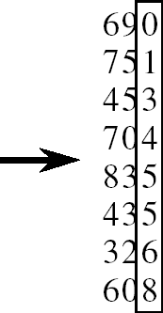
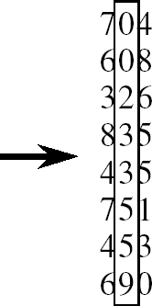
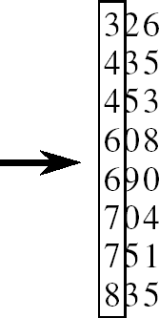
Radix Sort …
Alg.: RADIX-SORT(A, d)
for i ← 1 to d
do use a stable sort to sort array A on digit i
(stable sort: preserves order of identical elements)

Slide 12
Analysis of Radix Sort
Given n numbers of d digits each, where each digit may take up to k possible values, RADIX-SORT correctly sorts the numbers in O(d(n+k))
One pass of sorting per digit takes O(n+k) assuming that we use counting sort
There are d passes (for each digit)
Assuming d=O(1) and k=O(n), running time is O(n)

Slide 13
Bucket Sort

Slide 14
Bucket Sort
Assumption:
the input is generated by a random process that distributes elements uniformly over [0, 1)
Idea:
Divide [0, 1) into k equal-sized buckets (k=Θ(n))
Distribute the n input values into the buckets
Sort each bucket (e.g., using quicksort)
Go through the buckets in order, listing elements in each one
Input: A[1 . . n], where 0 ≤ A[i] < 1 for all i
Output: elements A[i] sorted

Slide 15
Bucket Sort ..
A
1
.78
.17
.39
.26
.72
.94
.21
.12
.23
.68
B 0 /
2
1
.17
.12 /
3
2
.26
.21
.23 /
4
3
.39 /
5
4
/
Distribute Into buckets
6
5
/
7
6
.68 /
8
7
.78
.72 /
9
8
/
10
9
.94 /

Slide 16
Bucket Sort ..
/
 |  |  | .12
 |  |  | .21
 |  |  | .39 | /
/
/
 |  |  | .68 | /
 |  |  | .72
/
 |  |  | .94 | /
0
1
2
3
4
5
6
7 |  |  |  |  |  | .78 | /
8
9
.17 | /
.23 |  |  |  | .26 | /
Sort within each bucket

Slide 17
Bucket Sort ..
.12 |  |  |  | .17
.21
.23
.26
.39
.68
.72
.78
.94 /
0
1
2
3
4
/
 |  |  | .12
 |  |  | .21
 |  |  | .39 | /
/
/
 |  |  | .68 | /
 |  |  | .72
/
 |  |  | .94 | /
.17 | /
.23 |  |  |  | .26 | /
5
Concatenate the lists from 0 to n – 1 together, in order
6
7
.78 /
8
9

Slide 18
Analysis of Bucket Sort
Alg.: BUCKET-SORT(A, n)
for i ← 1 to n
do insert A[i] into list B[⎣nA[i]⎦]
for i ← 0 to k - 1
do sort list B[i] with quicksort sort concatenate lists B[0], B[1], . . . , B[n -1] together in order
return the concatenated lists
O(n)
k O(n/k log(n/k))
=O(nlog(n/k)
O(k)
O(n) (if k=Θ(n))

